Slide 1
moose for dcs world TaskING

Slide 2
1. concepts

Slide 3

Tasking concept
Command
Center
Mission
Task
Group A
Task
Group B
Command
Center
Mission
Task
Group X
Task
Group Y
Mission
Task
Group Z

Slide 4
COMMAND CENTERS GOVERN MISSIONS
CommandCenter
CommandCenter
Mission
Mission
Mission
Task
Task
Task
Task
Group A
Group B
Group X
Group Y
Group Z
Group X
Multiple CommandCenters can govern multiple Missions for different coalitions (RED, BLUE).

Slide 5
Tasking framework
CommandCenter
Mission
Mission
Mission
Task
Task
Task
Task
Task
Group A
Group B
Group A
Group B
Group C
Group C
Missions have multiple Tasks.
Each Task is allocated to a Set of Groups.
Once a Player joins a Unit in the Group, the Task can be assigned to that Group.
A Task can be allocated by multiple Groups residing within the Set_Group, and can execute the Task in a cooperative manner!.
The same Group can be allocated to different Tasks, but in that case, if the Player joins a unit in the Group, only one Task can be ASSIGNED to that Group.

Slide 6

commandcenter
POSITIONABLE
Any Positionable.
Thus, a CommandCenter can be a Group, Unit, Static, Airbase.
A real object within the simulator. It is destructable. Once a CommandCenter is destroyed, all the Missions and Tasks cannot be coordinated anymore, and thus, all Missions and Tasks will be failed in such a situation.
The mission designer can opt to set the Positionable as undestructable within the mission editor.
CommandCenter
Mission
Task
Task
OBJECT
Group A
Group B
Takes care of the communication within the battlefield between the allocated Groups. This means it:
Provides the reporting and status updates.
Creates context menus for players to control the mission.
Notifies players of important events (of other players).
COMMUNICATES

Slide 7
Mission
A Mission governs the status of multiple Tasks.
CommandCenter
Mission
A Mission without an active task, has the status IDLE.
IDLE
Task
Task
Group A
Group B
A Mission having an assigned Task to a Group (joined by a Player), has the status ONGOING.
ONGOING
A Mission having all Tasks completed, has the status COMPLETED.
COMPLETED
A Mission can be FAILED if the treshold of failed Tasks has been trespassed.
FAILED

Slide 8
Task
A Task governs the process, assignment, execution and status of the achievements done by Players.
CommandCenter
Mission
A Task is a PROCESS executed by a Hierarchical Finite State Machine.
PROCESS
Task
Task
Group A
Group B
A Task can be assigned to a Group within the Mission.
ASSIGN
A Task governs the execution of the PROCESS by each UNIT of the player.
EXECUTE
A Task has state, meaning, each achievement within the PROCESS will result in a status change.
STATE

Slide 9
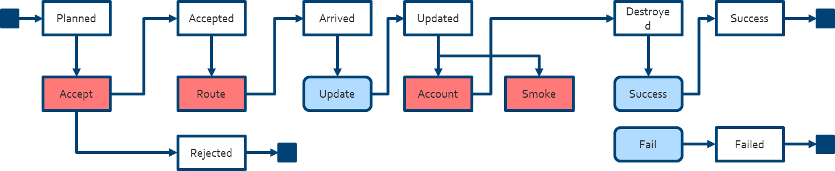
Task -> PROCESS
CommandCenter
Mission
PROCESS
Task
Task
A Task has a PROCESS “Template”, which describes what needs to be done within the Task. This PROCESS is not executed, but is only activated after assignment to a Group.
Group A
Group B
A PROCESS manages the transitioning between various states through events being triggered both internally as externally within the process.
STATE
A PROCESS manages the transitioning between various states through events being triggered both internally as externally within the process.
EVENT
A PROCESS can be Hierarchical. Meaning, that a PROCESS can call “SUB”-PROCESSes, that result in various states from which the main process can continue.
SUB-PRC

Slide 10
Task -> ASSIGN
ASSIGN
CommandCenter
Mission
Task
Task
PROCESS
Once a Player joins a UNIT of a Group, the PROCESS “Template” is copied to a new “Instance”, and assigned to the UNIT of the Player. Each UNIT with an alive Player executes this PROCESS.
Group A
Group B
PROCESS 1
PROCESS 1
PROCESS 2
PROCESS 2

Slide 11
Task -> EXECUTION
EXECUTE
CommandCenter
Mission
Task
Task
Group A
Group B
Running PROCESSes are assigned to the UNITs of the Group. So, each process runs independently from each other.
PROCESS
Players executing the Task, will share the same menu and the communication channel in that Group. Therefore, it is advisable to agree who is the leader of the group before or during mission assignment.
Group

Slide 12
Task -> states
STATE
CommandCenter
Mission
Planned
When a Task is created, it is set to state Planned.
Task
Task
The Task is currently Assigned to a UNIT (with a Player).
Assigned
Group A
Group B
Success
A Task is successfully finished when the Task Event :Success() is triggered.
:Success()
Aborted
A Task is Aborted when all players have aborted the Task. A Task can be set to aborted when the Task Event :Abort() is triggered.
:Abort()
Cancelled
The assigned Task has been cancelled by the CommandCenter, due to external dependencies in the Mission.
:Cancel()
Failed
A Task is Failed when the mission designer decides to do so… A Task can be set to failed when the Task Event :Fail() is triggered.
:Fail()

Slide 13
Task -> states -> Flow
TASK FSM
:Replan()
Planned
Assigned
Success
Failed
Aborted
Cancelled
:Start()
:Success()
:Fail()
:Abort()
:Cancel()
Player
First Player Join Slot
X Player Join Slot
Client/
Player Dead
Player Abort
UNIT
FSM
PROCESS
Success
Failed
Aborted
ACCEPT
Accepted
:Success()
:Fail()
:Abort()
Yes
Rejected
Command Center
Start Mission
Cancel Mission

Slide 14
CU next time
At the Eagle Dynamics Forums: https://forums.eagle.ru
Search for “MOOSE” on the forum
Or send me a Private Message to FlightControl
You can reach me on SKYPE with the ID: FlightControl_Skype
Or, join the SLACK.COM development community at
https://flightcontrol.slack.com/messages/moose/

